Slide 1
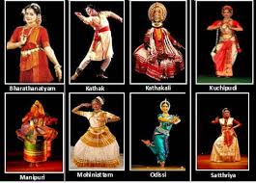
Classical Dances of India

Slide 2
Which dance from takes its name from words meaning, emotion, music and rhythm

Slide 3
Bharathnatyam (Bhav,Raga,tala)

Slide 4
Who recognizes classical dances

Slide 5
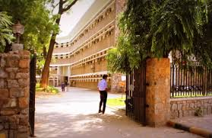
Sangeet Natak Akademy,

Slide 6
What does Bharatanatyam express ?

Slide 7
South Indian religious themes and spiritual ideas of Hinduism and Jainism

Slide 8
Which is the ancient Tamil epic that refers to Bharathnatyam

Slide 9
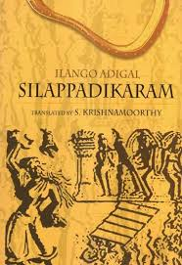
Silappatikaram( "the Tale of an Anklet“) attributed to a prince-turned-jain-monk Iḷaṅkō Aṭikaḷ

Slide 10
Which is the oldest classical dance tradition in India.

Slide 11
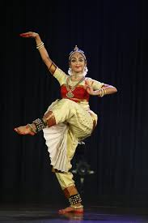
Bharatanatyam

Slide 12
What was the old name of Bharatanatyam

Slide 13
Sadiraattam, which was renamed in 1932 (In 1932, E Krishna Iyer and Rukmini Devi Arundale put forward a proposal to rename Sadiraattam
also known as Dasi Attam)

Slide 14
Which temple contain many poses of Bharatanatyam.

Slide 15
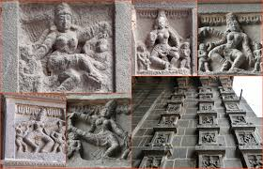
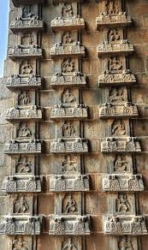
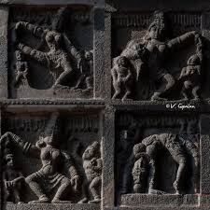
The Gopurams of the Chidambaram

Slide 16
What music is played for Bharathanatyam

Slide 17
The music used in Carnatic classical music, accompanied by instruments such as flute, violin and the Mridangam.

Slide 18
Who wrote Manimekalai?

Slide 19
Chithalai Chathanar

Slide 20
Who wrote Natya Shastra

Slide 21
Bharata Muni,

Slide 22
Which dance depicts scenes from lives of gods, Rama and Krishna

Slide 23
Kathakali

Slide 24
Dance form of A P

Slide 25
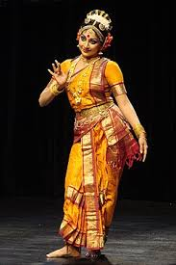
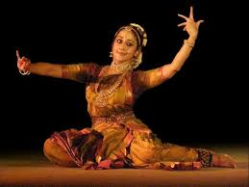
Kuchipudi

Slide 26
Who originally performed Kuchipudi

Slide 27
Bhagavathalu

Slide 28
Who played a key role in the development of Kuchupudi?

Slide 29
Siddhendra Yogi

Slide 30
Dance that has Persian and Central Asian dance forms

Slide 31
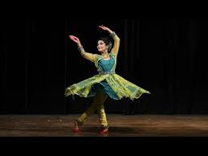
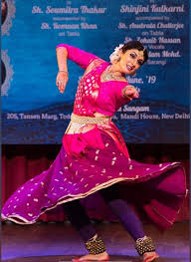
Kathak(means story teller )

Slide 32
Guru Kelucharan Mahapatra is associated with

Slide 33
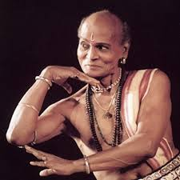
Odissi

Slide 34
What is the earliest form of present-day Odissi Dance.

Slide 35
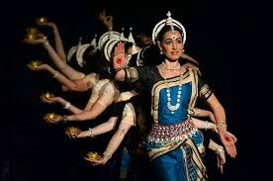
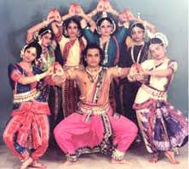
According to Natya Shastra, ‘Odhra Magadha’

Slide 36
Number of classical dances in India

Slide 37
8
Bharatanatyam, Kathak, Kathakali, Kuchipudi, Odissi, Manipuri, Mohiniyattam, and Sattriya

Slide 38
Which classical dance form is distinguished by the special postures with three independent body movements (head, chest and pelvis –tribhangi)

Slide 39
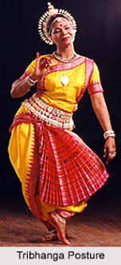
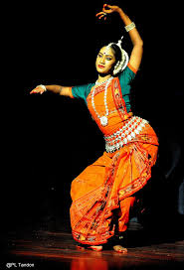
Odissi

Slide 40
Which dance form enacts the Radha Krishna raaslila

Slide 41
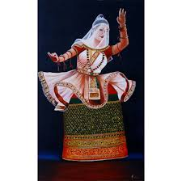
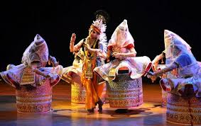
Manipuri dance

Slide 42
What is another name for Manipuri dance?

Slide 43
Jogoi

Slide 44
Who created the dance form Sattriya (Assam)

Slide 45
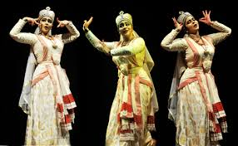
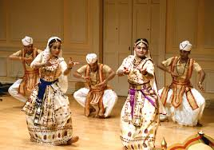
Srimanta Sankaradeva

Slide 46
Which dance form depicts temples of Brahmeswara , sun temple at konark and Jagnathpuri temple

Slide 47
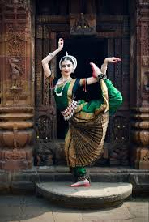
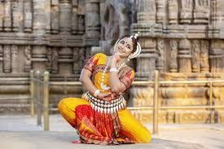
Odissi

Slide 48
From where did Kuchipudi originate

Slide 49
Kuchela puri

Slide 50
What is known as the ‘dance of every beautiful woman”

Slide 51
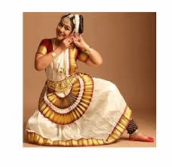
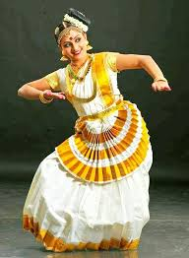
mohiniyattom

Slide 52
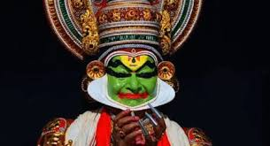
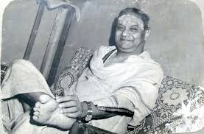
Kalamandalam Krishnan Nair

Slide 53
Kathakali
-

Slide 54
Dance performed in the temples of Tanjore

Slide 55
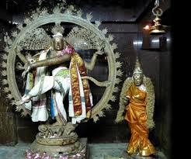
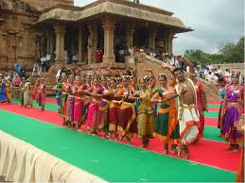
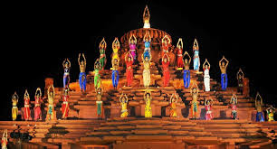
Bharathanatyam

Slide 56
Which dance form derives from Bharathanatyam and Kathakali

Slide 57

Mohiniattam

Slide 58
Ballet of the East

Slide 59
Kathakali

Slide 60
Tribhagha is associated with

Slide 61
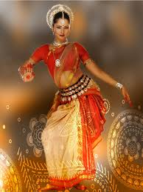
Odissi

Slide 62
Sonal mansingh

Slide 63
Bharatanatyam and Odissi

Slide 64
Raja Reddy

Slide 65
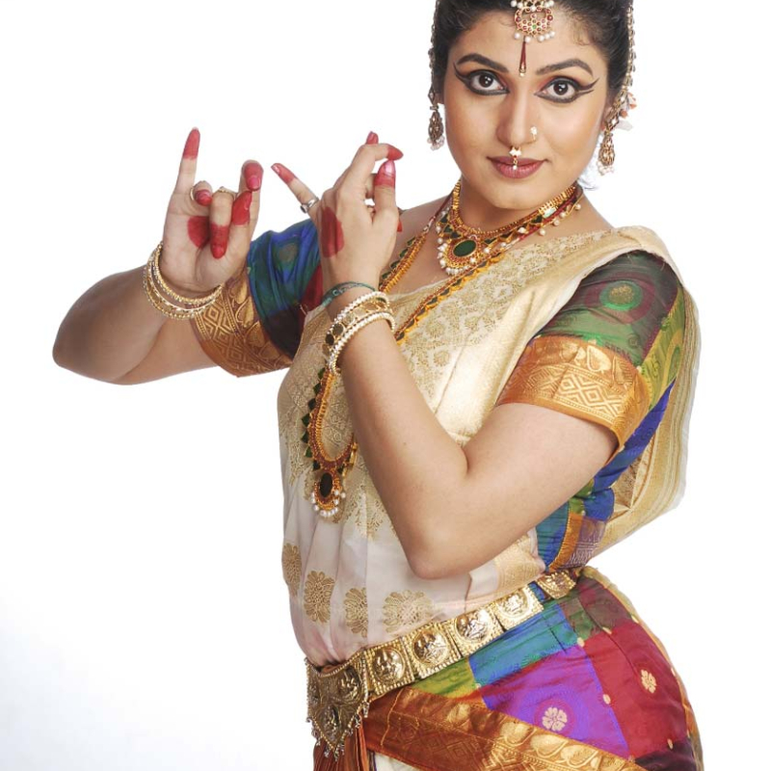
kuchipudi

Slide 66
Shambu Maharaj

Slide 67
Kathak

Slide 68
Rukmini Devi Arundale

Slide 69
Bharathnatyam
She was the first woman in Indian history to be nominated as a member of the Rajya Sabha
n January 1994, an Act of the Indian Parliament recognised the Kalakshetra Foundation as an 'Institute of National Importance’
In 2016, Google honored Rukmini Devi on her 112th birthday with a doodle
In 1977, Morarji Desai offered to nominate her for the post of President of India twice, which she turned down

Slide 70
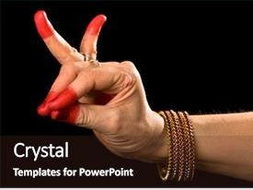
THE WORD KATHAK
It is primarily performed in Northern India.

Slide 71
means a story

Slide 72
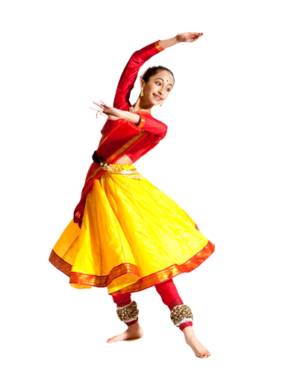
When did Kathak begin evolving into a distinct mode of dance
It was primarily a temple or village performance wherein the dancers narrated stories from ancient scriptures.

Slide 73
in the fifteenth and sixteenth centuries with the spread of the Bhakti movement.

Slide 74
Who patronized Kathak?
The legends of Radha-Krishna were enacted in folk plays called rasa lila, which combined folk dance with the basic gestures of the kathak story-tellers.

Slide 75
Under the Mughal emperors and their nobles, Kathak was performed in the court, where it acquired its present features and developed into a form of dance with a distinctive style.
Under the patronage of Wajid Ali Shah, the last Nawab of Awadh, it grew into a major art form.

Slide 76
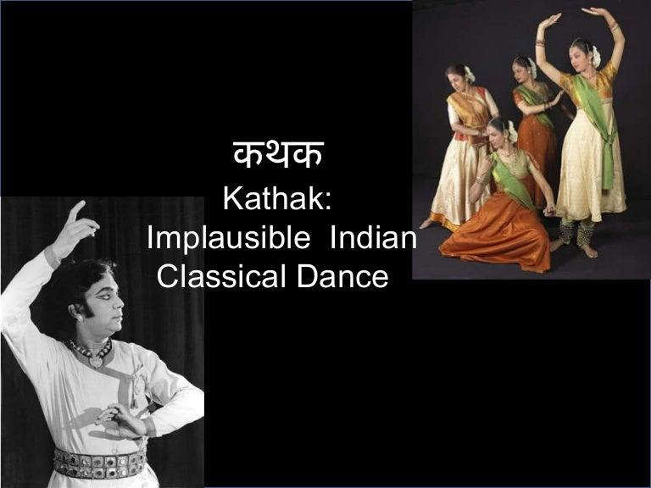
What is the Dance Style of Kathak?

Slide 77
Usually a solo performance, the dancer often pauses to recite verses followed by their execution through movement. The focus is more on footwork; the movements are skillfully controlled and performed straight legged by dancers wearing ankle-bells.

Slide 78
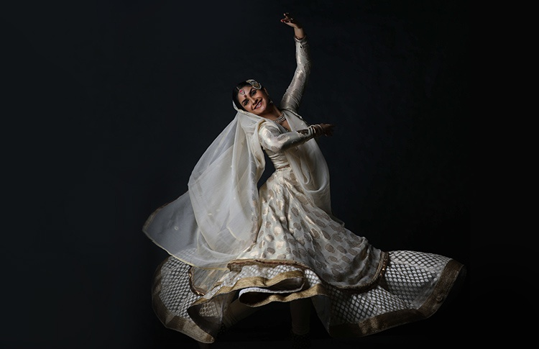
What are the Kathak Dance Techniques?

Slide 79
Kathak dance has two main techniques: 1) “nritya” (pure dance) 2) “Abhinaya” (expressions)

Slide 80
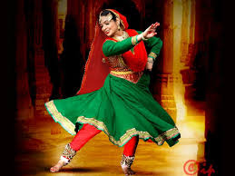
How is Kathak performed?

Slide 81
Kathak builds its pure dance sequences by combining units of movement.

Slide 82
The cadences called by the names tukra, tora, and parana are associated with what

Slide 83
Kathak

Slide 84
Which is the only classical dance of India having links with Muslim culture?( it represents a unique synthesis of Hindu and Muslim genius in art.)

Slide 85
Kathak
Kathak is the only form of classical dance wedded to Hindustani or the North Indian music. Both of them have had a parallel growth, each feeding and sustaining the other

Slide 86
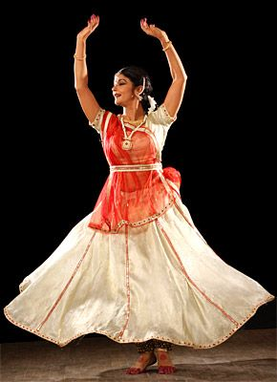
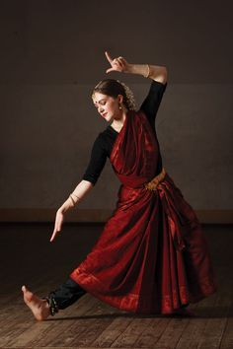
There are two types of Hindu costumes for female dancers.
a sari worn in a unique fashion complimented with a choli or blouse that covers the upper body and a scarf or urhni worn in some places
the other costume includes a long-embroidered skirt with a contrasting choli and a transparent urhni.

Slide 87
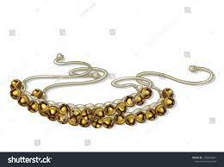
Kathak jewelleries are mainly ornamnets of gold and silver for head, arms , hands ,fingers , waist , feet and small ankle bells also called as ghungroos

Slide 88
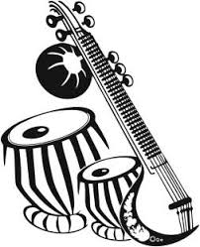
What are the Instruments associated with Kathak?

Slide 89
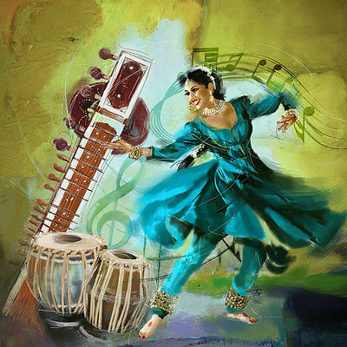
The tabla that harmonizes well with the rhythmic foot movements of the dancer and often imitates sound of such footwork movements or vice-versa to create a brilliant jugalbandi.
A manjira that is hand cymbals and sarangi or harmonium are also used most often.
A Kathak performance may include a dozen classical instruments depending more on the effect and depth required for a particular performance

Slide 90
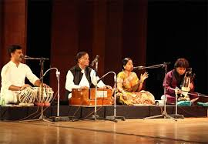
What do the texts sung by the singer and enacted by the dancer mostly recount

Slide 91
short episodes of Krishna’s life. Mystical Urdu love poems are also included in the repertoire.

Slide 92
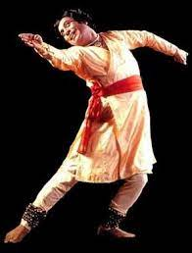
Famous exponents
Imminent personalities associated with Kathak include among others the founders of the different gharanas or schools of this form of classical dance namely Bhanuji of the Jaipur Gharana

Slide 93
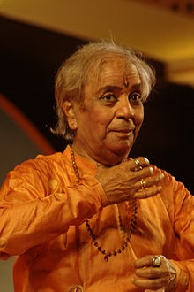
Janaki Prasad of the Benaras Gharana; Ishwari Prasad, Pandit Birju Maharaj of the Lucknow Gharana; and Raja Chakradhar Singh of the Raigarh Gharana.

Slide 94
In which of the following is reference of Indian Dance forms found?

Slide 95
Natya Shastra
The Nāṭya Śāstra is a Sanskrit text on the performing arts. The text is attributed to sage Bharata Muni, and its first complete compilation is dated to between 200 BCE and 200 CE, but estimates vary between 500 BCE and 500 CE.

Slide 96
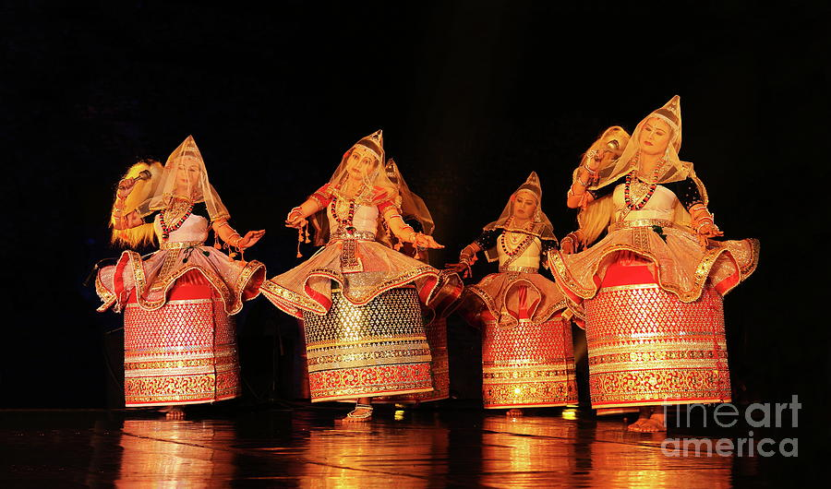
The Jagoi Dance is a dance form of which state ?

Slide 97
Manipur
Manipuri dance, also known as Jagoi, is one of the major Indian classical dance forms, named after the region of its origin – Manipur, a state in northeastern India bordering with Myanmar (Burma), Assam, Nagaland and Mizoram.

Slide 98
Which dance is based on Geethagovindam written by Jayadevan ?

Slide 99
Odissi dance

Slide 100
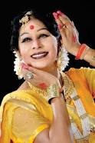
Shovana Narayan is best known as one of the best

Slide 101
Kathak dancers in the world.

Slide 102
Abhinaya Darpana by Nandikesvara talk about which dance form?

Slide 103
Bharathanatyam

Slide 104
A notable sculpture can be seen in Cave 1 of Karnataka’s Badami cave temples dating back to the 7th century where a 5 feet tall sculpture of Lord Shiva is depicted as Nataraja doing Tandava dance. The 18 arms of the Shiva sculpture expresses mudras or hand gestures of which dance ?

Slide 105
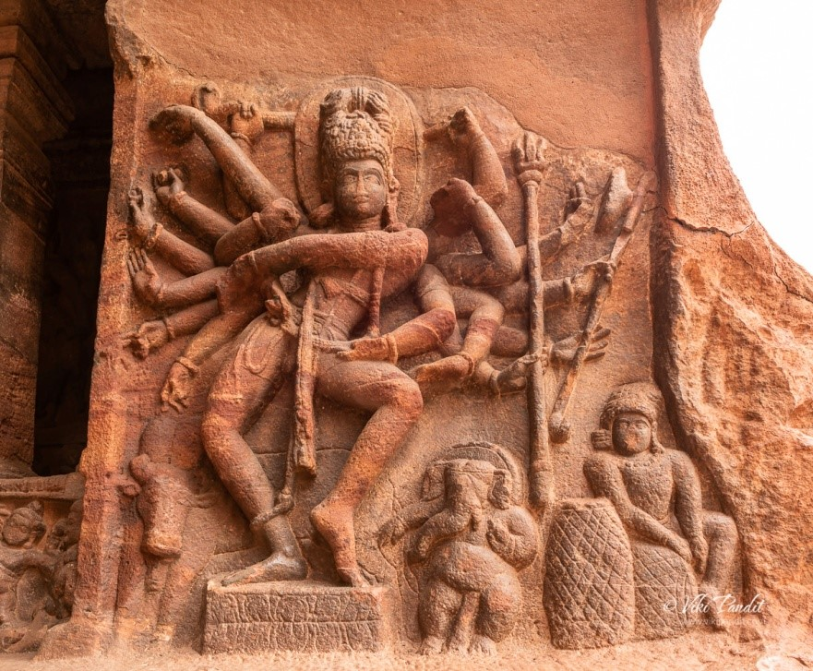
Bharatanatyam.

Slide 106
Which dance form is associated withEkaharya, where one dancer takes on many roles in a single performance

Slide 107
Bharathanatyam

Slide 108
What are the four Nattuvanars namely Ponaiyah, Vadivelu, Sivanandam and Chinnaiya who are renowned as Tanjore Bandhu associated with?

Slide 109
Bharathanatyam

Slide 110
Rukmini Devi who championed and performed the Pandanallur (Kalakshetra) style was the student of ?

Slide 111
Meenakshi Sundaram Pillai

Slide 112
CLASSICAL DANCERS
Bharatanatyam -
Rukmini Devi,
Padma Subrahmanyam,
Vyjayanthimala,
Sheema Kermani,
Padmini.

Slide 113
Kathak
-Birju Maharaj,
Nahid Siddiqui,
Lacchu Maharaj,
Gopi Krishna,
Saswati Sen,
Manjari Chaturvedi etc.

Slide 114
Kuchipudi
- Mallika Sarabhai,
V. Satyanarayana Sarma,
Deepa Shashindran, etc.
Raja and Radha Reddy,
Vempati Chinna Satyam,
Vedantam Satyanarayana Sarma
Shobha Naidu

Slide 115
Odissi -
Sujata Mohapatra,
Madhavi Mudgal,
Kelucharan Mohapatra,
Surendra Nath Jena,
Shobana Sahajananan

Slide 116
Mohiniyattam
- Kalamandalam Kalyanikutty Amma,
Shobhana,
Sunanda Nair,
Kalamandalam Radhika,
Thankamani,
Kalamandalam Hymavathy

Slide 117
Manipuri
- Guru Bipin Singh,
Darshana Jhaveri,
Jhaveri Sisters,
Devjani Chaliha,
Amala Shankar

